Slide 1
STATUS OF CMA ESTABLISHMENT IN THE EASTERN CAPE REGION 7 JANUARY 2013
S. Blie

Slide 2
HIGH LEVEL PROJECT PLAN FRAMEWORK
Aug12-July 13
Aug13-July 14
Aug 14-July 15 and beyond
Approach
CMA IMPLEMENTATION PLAN
Preparatory Phase
Establishment Phase
Operation Phase
Sustain & Improve
Gazetting of WMAs
1 Month
Implementation of Initial Functions
Delegation of functions
Project Phases
Cross Cutting Activities
Finalising Business Cases
Approval of Business Cases by NT and listing under PFMA
Office Accommodation
2 Months
Setting up of National Steering Committee
Gazetting of CMAs
Human Resources
8 Months
Setting up of Regional Steering Committees
Appointment of Governing Board
Systems
1 Month
Appointment of dedicated team
Appointment of Chief Executive
Budget secured MTEF
Time Frames
PHASE 1 : Breede-Gouritz, Inkomati-Usuthu and Pongola Mzimkhulu
PHASE 2 : Berg-Olifants-Doorn , Vaal , Olifants and Limpopo
PHASE 3 : Orange, Mzimvubu-Keiskamma
Aug12-July 13
Aug13-July 14
Aug14-July 15 and beyond

Slide 3
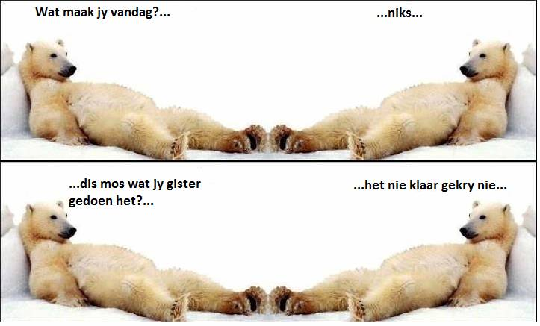
S. Blie

Slide 4
PRESENTION OUTLINE
Progress on the establishment of the RSC incl. TORs and Stakeholder Consultation
Progress on the Implementation Plan Communication Plan
Progress on the Development of the Business Case
Support Plan required for the CMA establishment Project
Challenges and Recommendations
S. Blie

Slide 5
(1) Progress on the Establishment of RSC
Process kick-starting the establishment of RCS commenced the late 2012 -Regional Consultation on 30 August 2012
RSC is in place as of the 10th of December 2012, however
TORs were discussed and adopted on the meeting of the 10th December
Second Meeting for Committee will be held / is scheduled for 11 February 2013, where the Draft Implementation Action Plan / Communication Plan will be tabled
External stakeholders are still to be included (Getting our house in order)
S. Blie

Slide 6
Stakeholder Consultations
The Region has engaged the Stakeholders in a small scale in the existing forums like ECWAC, NWRS 2 workshops, Bilaterals with Local Government & PROWAF
CMFs to revived and report to ECWAC/PROWAF
Newsletter will be finalised by the end of February which will be distributed bimonthly – specifically for both internal and external stakeholders (translated)
S. Blie

Slide 7
(2) Progress on the Implementation and Communication Plan
A detailed draft plan has been circulated to all the RSC members for comment for discussion on Monday the 11 February, 2013
2. ACTION PLAN FOR CMA ESTABLISHMENT (Detailed).xls
S. Blie

Slide 8
(3) Progress on the development of the Business Case
R500 000 made available from office of the
Regional Head for the appointment of a service provider
Tender is for 12 months for business case development
Evaluation of bids was on the 6 February 2013
Appointment will take place before 15
February 2013
S. Blie

Slide 9
Cont….
Target date for sending business case
proposal to Minister is end 2014
Establishment therefore is likely to be
2014 /15 prior the National targets
S. Blie

Slide 10
(4) Support Plan required for the
Project
There is a need for a continuous support from National Office
Secured budget
Clear national plan, targets and communication
Political engagement between Minister and Provincial political leadership and LG
S. Blie

Slide 11
Challenges
Uncertainty amongst officials
Functions to be clearly spelled out
What goes with whom?
and what remains with whom?
and when
Political engagements
S. Blie

Slide 12
(5) Recommendations
Clear communication plan
process to internal DWA officials to lay to rest uncertainties
Politicians
DWA Structure
Funding availability
S. Blie

Slide 13
THANK YOU

